Slide 1
What’s new and exciting about the Application Security Verification Standard 4.0
Josh Grossman, Head of Security Services for AppSec Labs and OWASP ASVS Project co-leader
January 2020 - MyDevSecOps

Slide 2


Slide 3
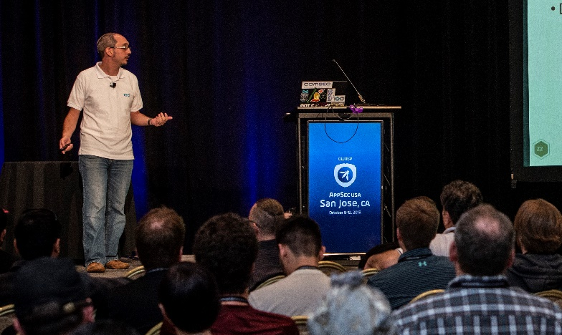

Josh Grossman
Over 10 years of IT Security, IT Risk and development experience
Application Security Consultant and Head of Security Services for AppSec Labs
Consulting for clients as well as speaking and training both internationally and locally

Slide 4


Josh Grossman
OWASP Israel Chapter Board member
Contributor to the OWASP Top Ten Proactive Controls project
Minor Contributor to OWASP Top 10 Risks and OWASP JuiceShop projects
Co-leader of the OWASP ASVS Project

Slide 5
The problem (thanks Michael Santarcangelo, @catalyst ☺)
I am a specialist in Application Security…
Working for AppSec Labs…
Active in the Open Web Application Security Project (OWASP)…
So people ask me…
How can we secure our applications…?

Slide 6
Today, I will be mostly discussing….
Background to the ASVS
What is the OWASP ASVS?
What is new in the 4.0 version?
What makes it interesting?
How you can you use it and get involved?

Slide 7
SO WHAT IS THE ASVS?

Slide 8
So WHAT IS THE ASVS? Well first, what isn’t the Asvs

Slide 9
The OWASP Top 10 Risks – The Good
OWASP releases every 3-4 years a list of the 10 Most Critical Web Application Security Risks:
Led by security experts from around the world who have shared their expertise.
Andrew van der Stock, Neil Smithline, Torsten Gigler, Brian Glas
Significant public comments and conversation on Top Ten 2017 choices
https://github.com/OWASP/Top10/tree/master/2017
Frequently cited application security awareness document
Notes:
Suggestions based on what experts were saying

Slide 10
The OWASP Top 10 Risks – The less good
Spread awareness regarding Web Security issues. It is not a standard.
Take note, PCI-DSS and others who incorrectly list it as one.
Not a comprehensive list
Bringing problems, not solutions
Notes:
No detail on exact issues, e.g. injection
Or on fixes

Slide 11
OWASP Top Ten Proactive Controls
Guidance document
Developer/builder focussed
Define Security Requirements
Leverage Security Frameworks and Libraries
Secure Database Access
Encode and Escape Data
Validate All Inputs
Implement Digital Identity
Enforce Access Controls
Protect Data Everywhere
Implement Security Logging and Monitoring
Handle All Errors and Exceptions
Notes:
Looking from the other side

Slide 12
Top Ten Proactive Controls – The Good
A great starting point
Gives practical prevention details
Also a great team:
Katy Anton, Jim Manico, Jim Bird

Slide 13
Top Ten Proactive Controls – The less good
Still not comprehensive
Again more for awareness
Not organised as a standard
Notes:
Awareness/starting point
Not an organized standard

Slide 14

So, watcha gonna do?

Slide 15
The OWASP ASVS!

Slide 16
What is the ASVS?
Requirements for a secure application
Designed to be an actual application security standard
Set of leading practices
Community and practitioner driven in the open
Split into 3 levels of requirement
Notes:
An actual standard
Comply in a methodical way
Things that should become the norm, eye on 2021, 2022
Things that you might not expect
Driven by the community, many eyes
Not small

Slide 17
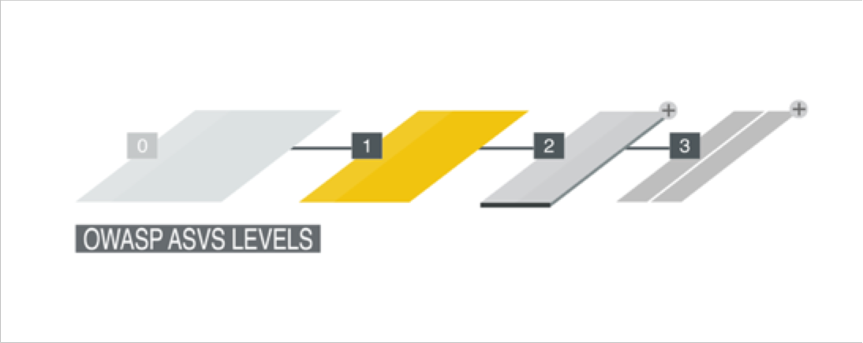
ASVS Level 1
Considered the “minimum” level
Designed for lower assurance levels
Vital stepping stone
~130 requirements

Slide 18
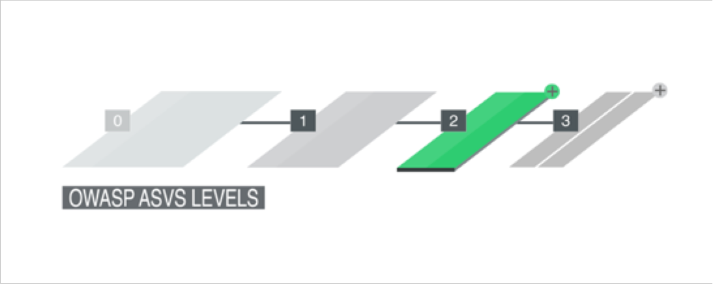
ASVS Level 2
Considered the “standard” level
For applications that contain sensitive data
Provides additional protections
Recommended level for most apps
~130 additional requirements

Slide 19
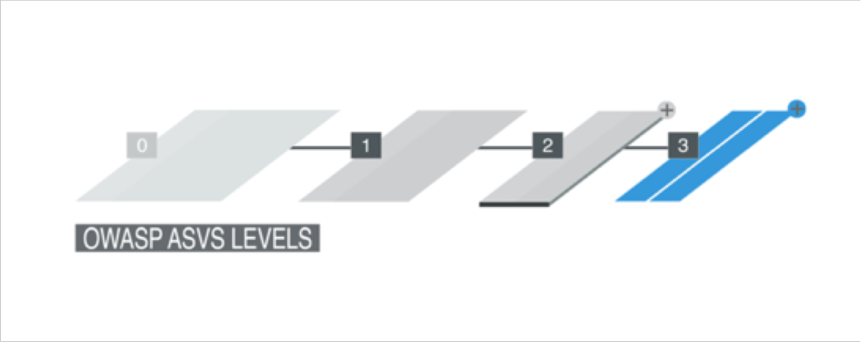
ASVS Level 3
Considered the “advanced” level
For the most critical applications
High value transactions
Sensitive medical data
Any other application that requires the highest level of trust.
~20 additional requirements

Slide 20
Who is involved?
Andrew van der Stock, Daniel Cuthbert, Jim Manico, Josh Grossman, Mark Burnett
Amazing contributors and reviewers such as Abhay Bhargarv, Elar Lang, ossie-git, Ron Perris, Tonimir Kisasondi, Serg Belokamen, Jason Axley, and Adam Caudill
You
Thanks to Andrew van der Stock for the slides that I based this deck on ☺

Slide 21
So what’s new?

Slide 22
What’s new
Now completely written in Markdown
Use script to generate other formats
Easy to determine what changed, when, by whom, and why
Easy to translate
NIST 800-63b compliance
Mappings (Proactive Controls, CWE, NIST, Cheat Sheets)
PCI DSS 6.5.x
Notes:
Easy to contribute, incremental changes
Digital Identity Guidelines: Authentication and Lifecycle Management
More about NIST later

Slide 23
What’s changed
Basically everything
Renumbered completely
Each section is reorganized and re-ordered
De-duped. Do not omit any section for your level
Notes:
Use all of the sections

Slide 24
L1 is the new minimum
Level 1 is considered the minimum
It is also now almost completely penetration testable

Slide 25
L2 should be the standard
Level 2 is what organizations should be aiming for.
Will need “behind the scenes” knowledge.
Stop penetration testing. White-box/Grey-box/Hybrid reviews at least!

Slide 26
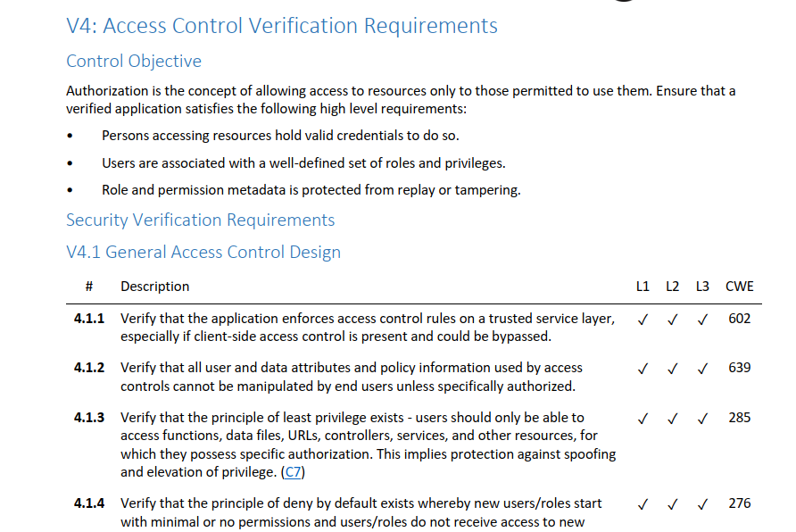
Notes:
This is what it looks like
Authentication
Some intro text and then controls built into sections
ID numbers, Level indicators, mapping to proactive controls, mapping to CWE, NIST mapping

Slide 27
ASVS Sections
V1: Architecture, Design and Threat Modeling
V2: Authentication
V3: Session Management
V4: Access Control
V5: Validation, Sanitization and Encoding
V6: Stored Cryptography
V7: Error Handling and Logging
V8: Data Protection
V9: Communications
V10: Malicious Code
V11: Business Logic
V12: File and Resources
V13: API and Web Service
V14: Configuration
Notes:
Not going to do one by one
Do something more focussed

Slide 28
What makes it interesting?

Slide 29
What makes it interesting? THE OWASP ASVS TOP 10 COOL features!!!

Slide 30
#1 – Revamped architecture section
V1 section completely revamped
Replaces “dead” section with something that can produce secure by default software
Covers architecture requirements for other sections
Requires Secure Software Development Lifecycle
Requires threat modeling
Design and build security in!
Levels 2 and 3 only
Notes:
Have to be built in from the start
Not too high a bar
Requirements page next

Slide 31
ASVS Sections
V1: Architecture, Design and Threat Modeling
V2: Authentication
V3: Session Management
V4: Access Control
V5: Validation, Sanitization and Encoding
V6: Stored Cryptography
V7: Error Handling and Logging
V8: Data Protection
V9: Communications
V10: Malicious Code
V11: Business Logic
V12: File and Resources
V13: API and Web Service
V14: Configuration
Notes:
Not going to do one by one
Do something more focussed

Slide 32
#1 – Revamped architecture section
V1 section completely revamped
Replaces “dead” section with something that can produce secure by default software
Covers architecture requirements for other sections
Requires Secure Software Development Lifecycle
Requires threat modeling
Design and build security in!
Levels 2 and 3 only
Notes:
Have to be built in from the start
Not too high a bar

Slide 33
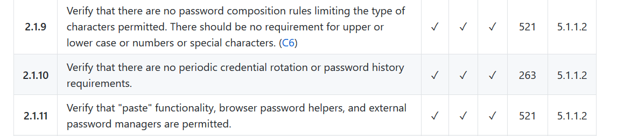
#2 – NIST Alignment
Aligned with NIST 800-63b
Except we had to go to 12 characters for SFA passwords
Notes:
Extra mapping
8 characters is a big nope….
Latest guidance
Actively

Slide 34
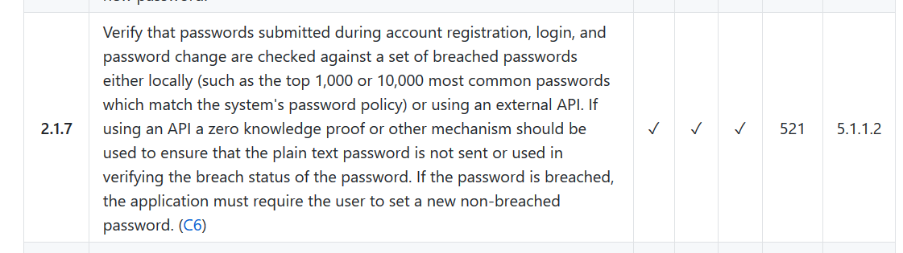
#3 – Actually useful practices
For example, https://haveibeenpwned.com/Passwords
Notes:
Not just theoretical
Useful against known and active threats
Compare to known bad lists
haveIbeenpwned
Or top 10000

Slide 35
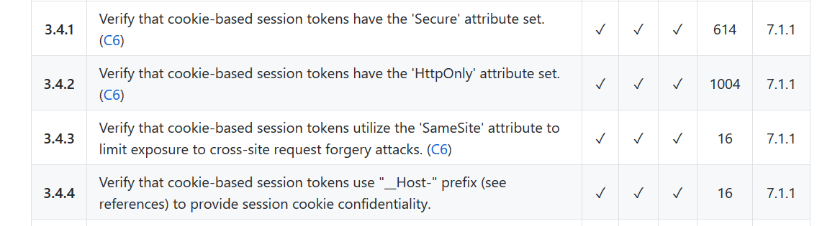
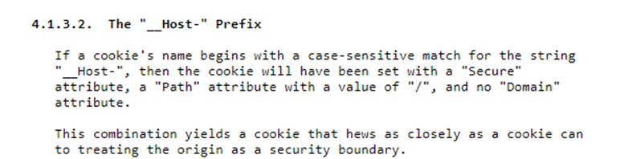
#4 – New, emerging protections
https://tools.ietf.org/html/draft-ietf-httpbis-rfc6265bis-03#section-4.1.3
Notes:
Cutting edge
https://tools.ietf.org/html/draft-ietf-httpbis-rfc6265bis-03#section-4.1.3
From the author, this feature is “shipping in practically every browser”
Secure, simple path and no domain

Slide 36
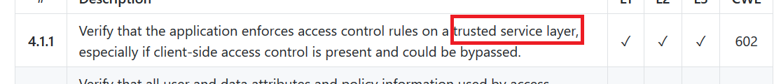
#5 – No more servers
Covers serverless and cloud access control (”server-side” is gone)
Notes:
Where do you verify access control? – Not the server-side anymore
Fit modern applications

Slide 37
#6 – Today’s vulnerabilities, today
Server Side Request Forgery is the new hotness
But not yet in the OT10….
Notes:
SSRF is everywhere
Not as popular in 2017
Need a standard to stay relevant
Doesn’t need to replace something in a top 10

Slide 38
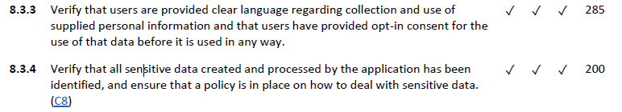
#7 – The Data Protection trend
Notes:
GDPR
Aims to be comprehensive
Need to privacy this to have hat

Slide 39
#8 – Not just the obvious
Notes:
normal use?
Call centre employees
Using the application in a technically valid but undesirable way

Slide 40
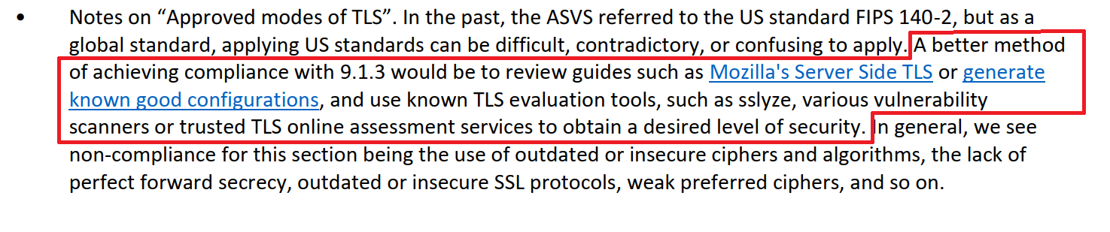
#9 – But how do I do it…?
Notes:
Focus on current leading practice
Cheat sheets
Use updated tools and config builders

Slide 41
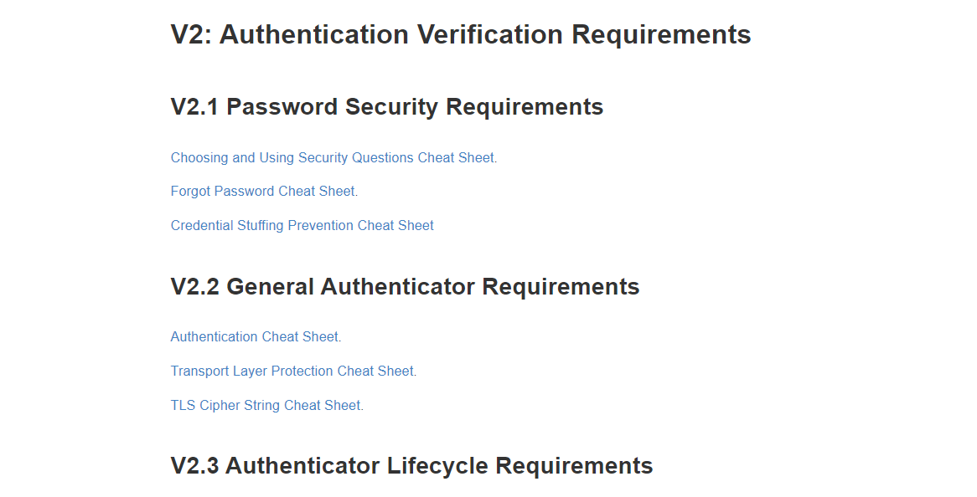
#9 – But how do I do it…?
Notes:
Focus on current leading practice
Cheat sheets
Use updated tools and config builders

Slide 42
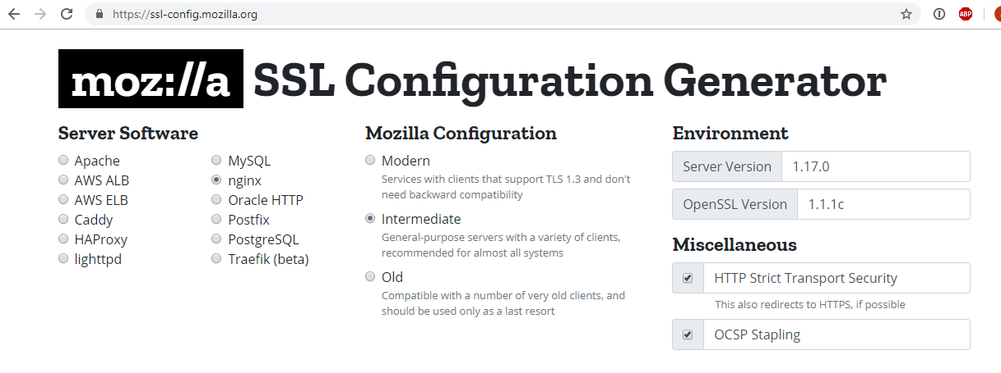
#9 – But how do I do it…?

Slide 43
#10 – Spawn of ASVS!
Mobile Application Security Verification Standard
Container Security Verification Standard
Software Component Verification Standard
IoT Security Guidance / IoT ASVS Appendix
Smart Contracts Security Verification Standard (Not OWASP)
Active Directory Security Verification Standard (Not OWASP)
Verification Standard Security Verification Standard…

Slide 44
Mobile ASVS
Focused on mobile specific issues (client-side and transport security)
Provides platform independent guidance
Application server side should be assessed using the main ASVS
Similar structure to main ASVS
Different team – the OWASP Mobile Security project
Very closely linked to the OWASP Mobile Security Testing Guide

Slide 45
I’m in. How do I use it?

Slide 46
ASVS in the SDLC – When?
Preparing secure requirements
Designing securely and designing security features
Secure implementation guidance
Develop tests around ASVS requirements
Application Penetration Testing (to discuss later)

Slide 47
ASVS in the SDLC – Key reminders
Ongoing assistance and support
Make it fit your business
Everyone involved
Part of a wider Secure SDLC (see, OWASP SAMM)

Slide 48
ASVS in Procurement
Has guidance for using 3rd party software
For vendors, focus on ASVS requirements you care about the most
Note the interactions with the vendor
For a security product, what are you expecting them to cover?

Slide 49
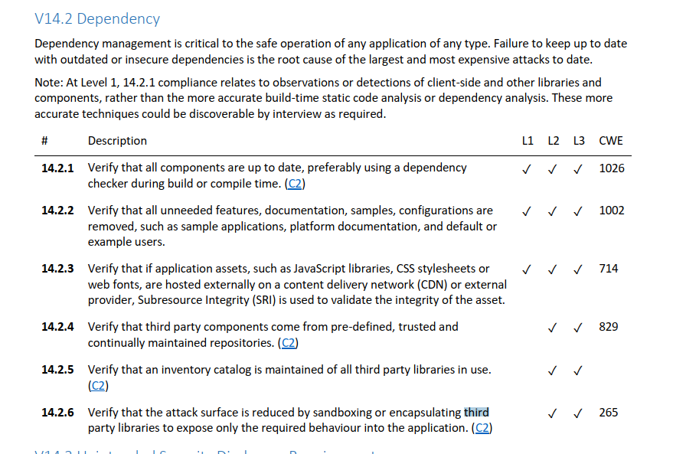

Slide 50
ASVS in Procurement
Has guidance for using 3rd party software
For vendors, focus on ASVS requirements you care about the most
Note the interactions with the vendor
For a security product, what are you expecting them to cover?

Slide 51
ASVS for Risk Identification
Design Review – Catching issues early on
Developer testing/QA – Create automated tests
Application Penetration Testing (internal or 3rd party) – provides a framework for testing

Slide 52
I’m in. How do I FIND it?

Slide 53
When can I get it?
The ASVS 4.0.1 Final is available now!
OWASP Website – Word, PDFs, CSVs, and Hot Linkable markdown
GitHub – Most Recent Static Version is in the 4.0.1 branch
https://github.com/OWASP/ASVS/tree/v4.0.1
GitHub – Development Version is in the master branch
https://github.com/OWASP/ASVS
You can also get the base version of this presentation so you can give this to your local chapter, school, college, or workplace! (Thanks to Andrew van der Stock!)

Slide 54
How to get involved
Grab a copy today and start to migrate from earlier versions and T10
We need translations. Please join the #project-asvs channel on OWASP Slack
We need case studies! If you use ASVS, we’d love to hear from you!
Create issues or pull requests if you identify issues
https://github.com/OWASP/ASVS

Slide 55
Thank you
josh.grossman@owasp.org (OWASP)
josh@appsec-labs.com (work)
@JoshCGrossman (Twitter)
https://owasp.org/www-project-application-security-verification-standard/
@OWASP_ASVS (ASVS on Twitter)
https://github.com/OWASP/ASVS (ASVS on GitHub)
https://app.slack.com/client/T04T40NHX/C06MNF14M (#project-asvs on OWASP Slack)

